Slide 1
Computer fundamentals and office applications.
Name: Ruma Roy
Batch : 6th
Title : The history of the origin of different types of sarees as culture and tradition of Bengal.

Slide 2

Proposal link:https://docs.google.com/spreadsheets/d/1vfFtaIFkrNnv_SLvDp_z7kyYa7RIBdz5hJjbaAYGk_s/edit?usp=drivesdk
Data Link: https://docs.google.com/document/d/1sNopdknJ76L6LUNNOopopisAZbNSFdJEF uWoJ2TbHlU/edit?usp=drivesdk

Slide 3

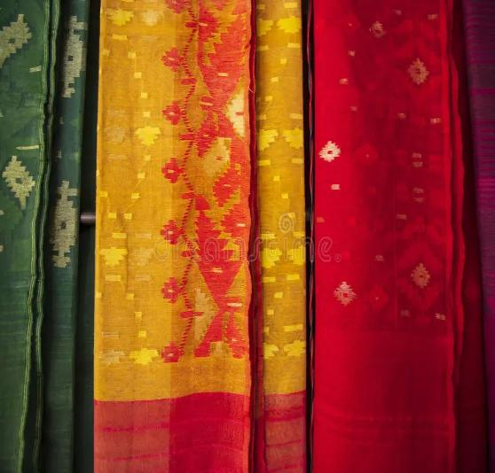
Introduction
The history of the origin of different types of sarees in Bengal is deeply intertwined with the region's rich cultural and traditional heritage. Bengal, a region that encompasses modern-day West Bengal in India and Bangladesh, has a vibrant textile tradition that dates back centuries.
The saree, a quintessential Indian garment, is not just a piece of clothing but a symbol of the region’s history, artistry, and cultural identity.

Slide 4

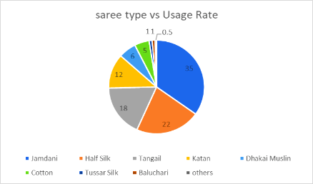
Q1.Which sarees are currently being used in Bangladesh?

Slide 5

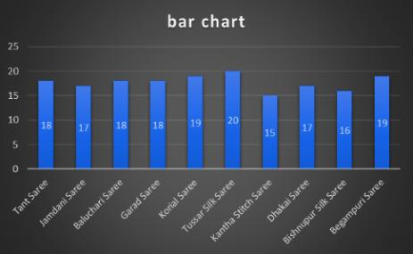
Q2.Which sarees are becoming traditional of Bengal?

Slide 6
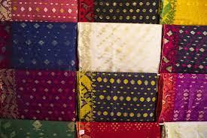
Q3.Which sarees in Bangladesh have been recognized as world heritage?
Q4.Which sarees are named after the district?

Slide 7
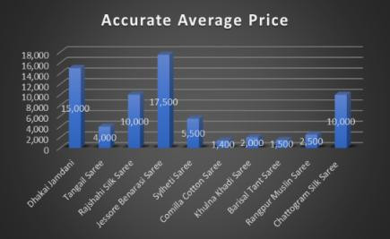
Q5.What are the famous sarees of different sections of Bangladesh?

Slide 8

Conclusion
The saree is an integral part of Bengal's cultural fabric, embodying the region’s history, art, and tradition. From the delicate weaves of Jamdani to the narrative richness of Baluchari, each type of Bengali saree tells a unique story, reflecting the region’s diverse heritage and the timeless artistry of its weavers.

